Slide 1
ROOPINI PV
(311521104041)
FINAL PROJECT
GEN AI

Slide 2
PROJECT TITLE
MEETING SUMMARIZER USING TRANSFORMER

Slide 3

AGENDA
PROBLEM STATEMENT
PROJECT OVERVIEW
WHO ARE THE END USERS?
YOUR SOLUTION AND ITS VALUE PROPOSITION
THE WOW IN YOUR SOLUTION
MODELLING
RESULTS

Slide 4

PROBLEM STATEMENT
Traditional manual summarization of meeting discussions is time-consuming and prone to human error, hindering productivity and decision-making. The need for an automated solution that efficiently extracts key insights from meeting transcripts to generate concise summaries, enhancing organizational efficiency and collaboration, is evident.

Slide 5

PROJECT OVERVIEW
AI Meeting Summarizer aims to streamline the meeting process by automating the extraction of key insights from meeting transcripts. Leveraging advanced natural language processing (NLP) techniques, the system generates concise summaries, enhancing productivity, collaboration, and decision-making within organizations

Slide 6
END USERS
Organizational stakeholders such as executives, managers, team leads, and project members who regularly participate in meetings and require efficient access to summarized meeting insights. Additionally, administrative staff responsible for scheduling and organizing meetings may also benefit from the system.

Slide 7

SOLUTION AND VALUE PROPOSITION
The solution offered by the AI Meeting Summarizer lies in its ability to automate the summarization of meeting discussions, leveraging advanced NLP techniques to generate concise summaries. Its value proposition includes saving time and enhancing productivity by efficiently extracting key insights from meeting transcripts, improving decision-making, collaboration, and knowledge retention within organizations.

Slide 8

WOWS IN THE SOLUTION
Efficiency: Automation streamlines the summarization process, saving time and effort.
Accuracy: Advanced NLP techniques ensure accurate extraction of key insights from meeting discussions.
Productivity: Concise summaries facilitate better decision-making and collaboration among team members.
Accessibility: User-friendly interface allows easy input and access to summarized meeting insights.
Scalability: System can handle meetings of varying sizes and complexities, accommodating organizational needs.
Innovation: Leveraging cutting-edge technology revolutionizes traditional meeting processes, improving overall efficiency.

Slide 9
MODELLING
Input Meeting Transcript:
Start with the input of meeting transcripts, which serve as the raw data for the summarization process.
Data Preprocessing:
Preprocess the meeting transcripts to clean and standardize the text, including tasks such as tokenization, normalization, and data augmentation.
Model Selection:
Choose an appropriate Transformer-based NLP model (e.g., BART, GPT) for summarization, based on factors such as performance and computational requirements.
Model Fine-Tuning:
Fine-tune the selected model on a dataset of meeting transcripts to adapt it to the specific task of summarization, optimizing parameters for improved performance.
Summarization Process:
Process the preprocessed meeting transcripts using the fine-tuned model to generate concise summaries of meeting discussions.
Output Summary:
Output the generated summaries, which capture the key insights and important points discussed during the meeting.

Slide 10
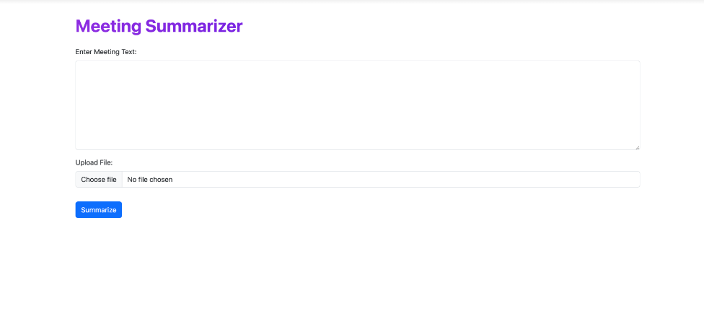
RESULTS

Slide 11
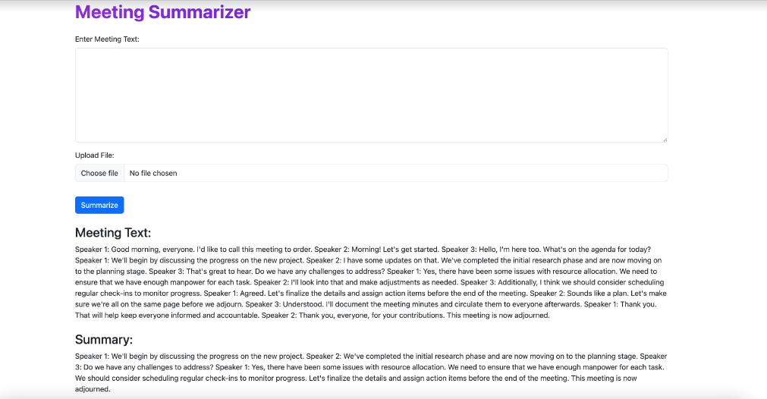

Slide 12
